Slide 1
Describe weapons of TOTALITARIANISM
How do you control people?

Slide 2
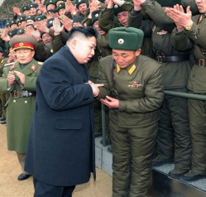
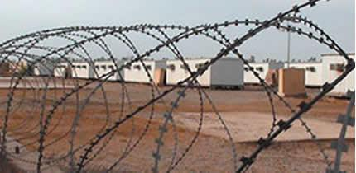
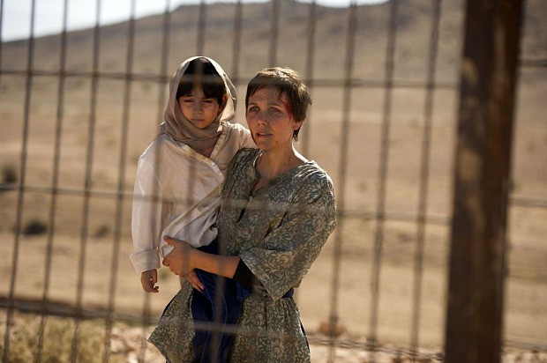
State control of individuals
Demands loyalty
Denies basic liberties
Expects personal sacrifice for the good of the state

Slide 3
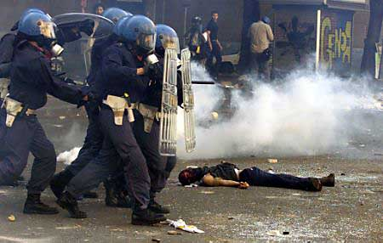
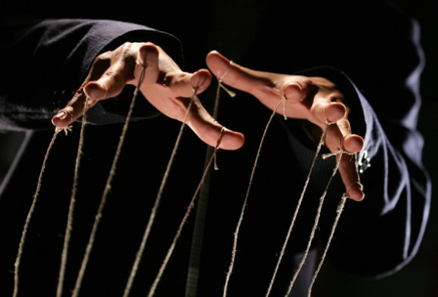
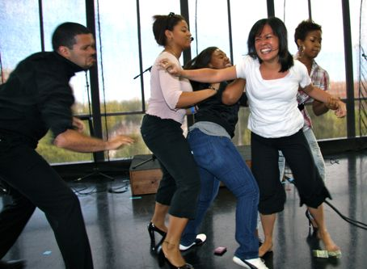
Methods of Control
Police terror
Indoctrination
Censorship
Persecution

Slide 4
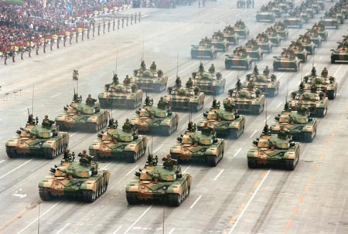
Modern Technology
Mass communication to spread propaganda
Advanced military weapons

Slide 5
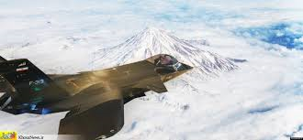
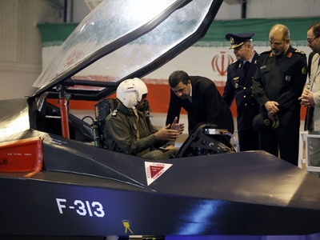
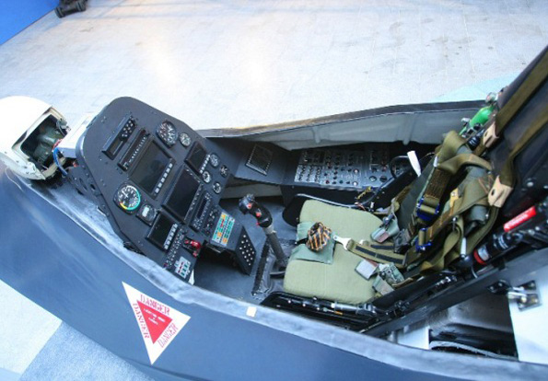
Like in Iran….

Slide 6
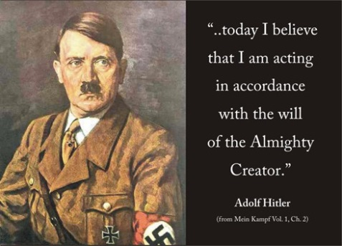
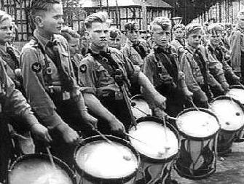
State Control of Society
Business
Labor
Housing
Education
Religion
The arts
Personal life
Youth groups

Slide 7
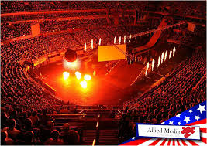
Dictatorship and One-Party Rule
Exercises absolute authority
Dominates the government

Slide 8
Dynamic Leader
Unites people-
Symbolizes government-
Encourages popular support through force of will-

Slide 9
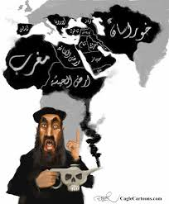
Ideology
Sets goals of the state……..
Glorifies aims of the state…………………
Justifies government actions…

Slide 10
Describe the seven weapons of TOTALITARIANISM : found on “Page 441”
State control of individuals
Methods of Control
Modern Technology
State Control of Society
Dictatorship and One-Party Rule
Dynamic Leader
Ideology

