Slide 1
Post war uncertainty and Progress
Chapter 15 Section 1

Slide 2
Science
Challenged old theories and practices:
Albert Einstein-German Physicist (Jewish)
*Theory of Relativity- The laws of physics are the same everywhere…even in space!
Sigmund Freud-Austrian Physician
*Treatment of people with psychological problems (Problems of the mind)
*Psychoanalysis and Dream interpretation
*Id, Ego, Super-ego

Slide 3
Literature
Authors wrote about the uncertainty of the times and the horrors of WWI
*Wrote about things they could not explain or escape.
Existentialism- The search for the meaning of life in an uncertain world.
*Create your own meaning of life through your choices and actions.
*Friedrich Nietzsche-Opposed: Western thought, reason, democracy, progress. Supported: pride, assertiveness, strength

Slide 4
Authors Kierkegaard, Nietzsche, Kafka, Dostoevsky

Slide 5
Art
Rebellion from “Realism” (too real, too scary)
Expressionism-Painters go “internal” to the world of imagination and emotion.
*Show realistic representations of objects with bold colors and distorted or exaggerated forms.

Slide 6
Expressionism The Scream by Munch

Slide 7
Deer in Woods By Franz Marc

Slide 8
Art continued…
Surrealism-“Dream World” artistic expression
Expression beyond and above reality, eerie dream like qualities with unrealistic imagery.

Slide 9
The Red Tower by Chiricos

Slide 10
L’Ange du Foyr by Ernst

Slide 11
The Persistence of Memory by Dali

Slide 12
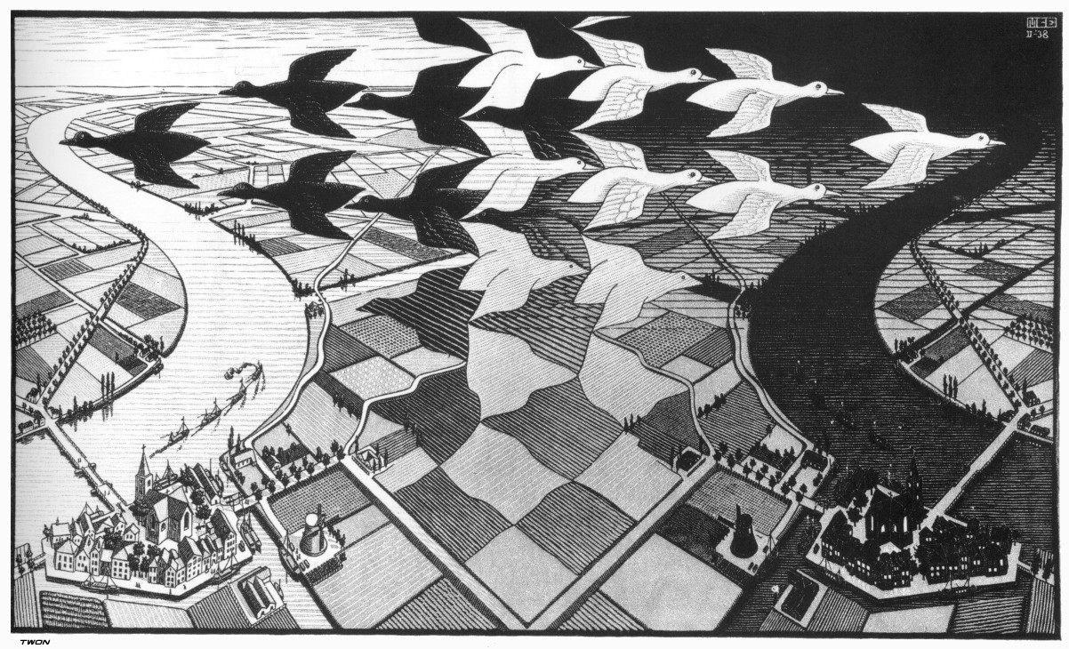
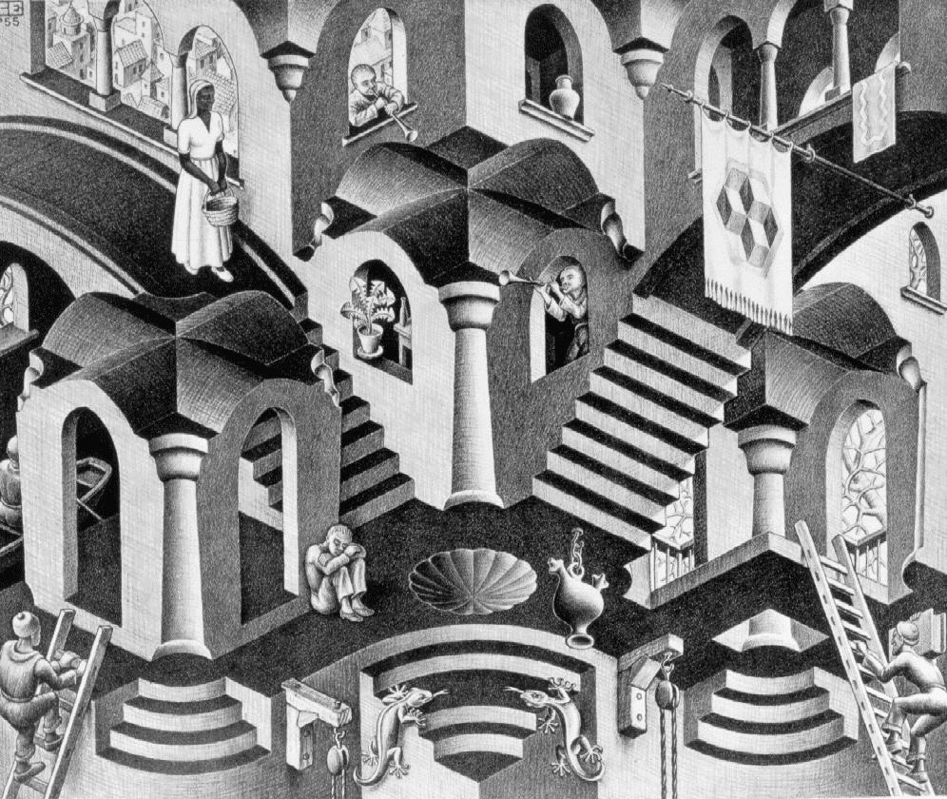
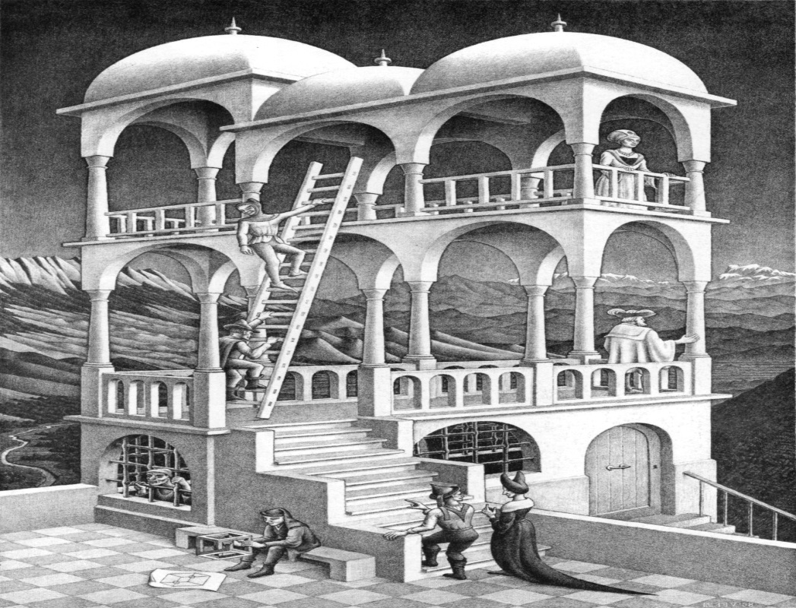
M.C. Escher

Slide 13
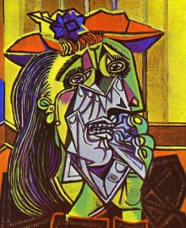
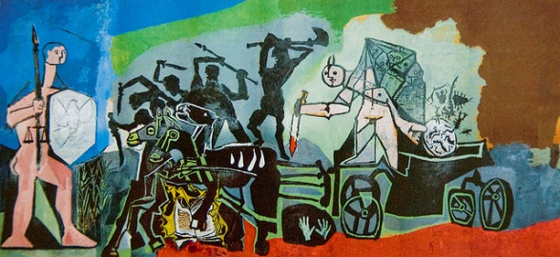
Picasso

Slide 14
Music
Music of the twenties shunned traditional classical styles.
Jazz- Emerges from the United States, New Orleans, Chicago, and New York. Carefree, impromptu style that represented the freedom of the era. Music of choice for the “Flapper”; The best Jazz came from Harlem in New York City.

Slide 15
Social Change
Women’s suffrage- A women’s right to vote
*The most significant change will be for Women, they represent 50% of the population.
*For 70 years in America they outwardly protested their lack of voting rights.
*19th Amendment, 1920 women’s vote
*New Zealand in 1893 is often said to be the first country in the world to give women the right to vote. A contestant for being the first nation to grant women the right to vote would be Sweden, where conditional woman suffrage was granted during the age of liberty between 1718 and 1771 to taxpaying women listed in their guilds as professionals
*Others follow (Germany, Britain, Austria, Sweden)

Slide 16
Women’s Vote Worldwide
18th century
1718
Sweden Female taxpaying members of city guilds are allowed to vote in local elections (rescinded in 1758) and national elections (rescinded in the new constitution of 1771).
1755
Corsica (rescinded upon annexation by France in 1769)[
1756–1778
One woman, Lydia Taft, is allowed to vote in Uxbridge, Massachusetts town meeting
1776
New Jersey propertied widows (rescinded in 1807)
1795
Poland prior to the Partition of Poland in 1795, tax-paying females were allowed to take part in political life
19th century
1838
Pitcairn Islands
1861
South Australia (Only property-owning women for local elections universal franchise in 1894)
1862
Sweden (only in local elections, votes graded after taxation, universal franchise in 1919, which went into effect at the 1921 elections)^{[4]}
1863
The Grand Principality of Finland was part of the Russian Empire from 1809 to 1917 and enjoyed a high degree of autonomy. In 1863, taxpaying women were granted municipal suffrage in the country side, and in 1872, the same reform was given to the cities^{[4]}
1864
Statue of Esther Hobart Morris in front of the Wyoming State Capitol
Women in Victoria, Australia were unintentionally enfranchised by the Electoral Act (1863), and proceeded to vote in the following year's elections. The Act was amended in 1865 to correct the error.^{[5]}
In the former Kingdom of Bohemia, taxpaying women and women in "learned professions" were allowed to vote by proxy and made eligible to the legislative body in 1864.^{[4]}
1869
United Kingdom (only in local elections. Partial female suffrage in general elections in 1918; universal franchise in 1928.)
1869–1920
States and territories of the USA, progressively, starting with the Wyoming Territory in 1869 and the Utah Territory in 1870, though the latter was repealed by the Edmunds-Tucker Act in 1887. Wyoming acquired statehood in 1890 (Utah in 1896), allowing women to cast votes in federal elections. The United States as a whole acquired women's suffrage in 1920 (see below) through the Nineteenth Amendment to the United States Constitution; voting qualifications in the U.S., even in federal elections, are set by the states, and this amendment prohibited states from discriminating on the basis of sex.
1870
Utah Territory
1872
Grand Principality of Finland was part of the Russian Empire from 1809 to 1917 and enjoyed a high degree of autonomy. In 1872, taxpaying women were granted municipal suffrage in the cities^{[4]}
1881
Isle of Man (only property-owners until 1913, universal franchise in 1919.)
1884
Canada Widows and spinsters granted the right to vote within municipalities in Ontario (later to other provinces).

Slide 17
1889
Franceville grants universal suffrage.Loses self-rule within months.
1893
Tribute to the Suffragettes, Christchurch, New Zealand
Colorado
New Zealand (including Maori women; although women were barred from standing for election until 1919)
Cook Islands
1894
South Australia grants universal suffrage, extending the franchise to all women (property-owners could vote in local elections from 1861), the first in Australia to do so. Women are also granted the right to stand for parliament, making South Australia the first in the world to do so.
United Kingdom extends right to vote in local elections to married women.
1896
Idaho
1899
Western Australia
20th century
1900s
1902
Commonwealth of Australia (The Australian Constitution gave the federal franchise to all persons allowed to vote for the lower house in each state unless the Commonwealth Parliament stipulated otherwise. Thus, South Australian and Western Australian women could vote in the first federal election in 1901. During the first Parliament, the Commonwealth passed legislation extending federal franchise to non-Aboriginal women in all states.)
New South Wales

Slide 18
1903
Tasmania
1905
Queensland
First Female Parliamentarians in the world were elected in Finland in 1907.
1906
The Grand Principality of Finland was the first country to have universal suffrage. First country to give the right to vote and right to stand for elections to everyone of age regardless of wealth, race or social class.^{[9]}
New Hebrides Perhaps inspired by the Franceville experiment, the Anglo-French Condominium of the New Hebrides granted women the right to vote in municipal elections and to serve on elected municipal councils. (These rights applied only to British, French, and other colonists, not to indigenous islanders.)^{[10]}
The argument over women's rights in Victoria was lampooned in this Melbourne Punch cartoon of 1887
1908
Denmark (only in local elections, with Iceland and the Faroe Islands)
Victoria
1910s
1910
Washington
1911
California
Argentina (A doctor, Julieta Lanteri, sued and won the right to vote)
1912
Oregon
Kansas
Arizona
1913
Alaska
Norway
1914
Montana
Nevada

Slide 19
1915
Denmark (full voting rights, with Iceland)
1916
Manitoba
Saskatchewan
Alberta
1917
New York
Azerbaijan Democratic Republic
Armenia
Belarusian People's Republic
Estonia
Latvia
Lithuania
British Columbia
Ontario
Canada (limited to war widows, women serving overseas, and women with family serving overseas)
Poland
Russian Republic
Ukrainian People's Republic
Uruguay (per Constitution)
1918
Michigan
South Dakota
Oklahoma
Austria
Canada (for women over 21, and "not alien-born", and meeting provincially-determined property qualifications)
Nova Scotia
Germany
Moldavian SSR
United Kingdom (see Representation of the People Act 1918: women above the age of 30, compared to 21 for men and 19 for those who had fought in World War One. Various property qualifications remained.)
1919
Belgium (only at municipal level)
Georgia
Hungary (full suffrage granted in 1945)
Luxembourg
Netherlands (right to stand in election granted in 1917)
New Zealand (along with voting rights, women now allowed to stand for election into parliament)
New Brunswick (women could not stand for office in New Brunswick until 1934)
Minnesota
Southern Rhodesia (women now allowed to vote and stand for election into parliament)

Slide 20
1920s
1920
Albania
Czechoslovakia
United States (all remaining states by amendment to federal Constitution)
1921
Sweden
1922
Irish Free State—now known as the Republic of Ireland—(equal suffrage granted upon independence from UK. Partial suffrage granted as part of UK in 1869 and 1918)
Prince Edward Island
Burma
Yucatán, Mexico (regional and congress elections only)
1924
Ecuador (A doctor, Matilde Hidalgo de Prócel, sued and won the right to vote)
Spain (Vote for single women and widows in local elections. First women mayors)
Mongolia (No electoral system in place prior to this year)
Saint Lucia
Kazakh SSR
Tajik SSR
1925
Italy (local elections only)
Dominion of Newfoundland—franchise only at age 25, men could vote at age 21
1927
Turkmen SSR
Uruguay (Women's suffrage was broadcast for the first time in 1927, in the plebiscite of Cerro Chato)
1928
United Kingdom (franchise equal to that for men)
1929
Romania (local elections only, with restrictions)^{[11]}
Puerto Rico (to vote)
Ecuador (The right of women to vote was written into the Constitution)
1930s
1930
South Africa (Women's Enfranchisement Act, 1930; only granted to white women on the same basis as white men)
Turkey In Turkey women won the right to vote in municipal elections on March 20, 1930. Turkey holds first election that allows women to vote.^{[12]} On December 5, 1934 they were granted full universal suffrage. Turkish women who participated for the parliament elections as a first time on February 8, 1935 obtained 18 seats.

Slide 21
1931
Ceylon (Sri Lanka)
Chile (only at municipal level for female owners of real estate; Legislative Decree No. 320)
Portugal (with restrictions following level of education)
Spain (universal suffrage)
1932
Brazil - Berta Lutz
Maldives
Thailand (Siam)
1934
Chile (only at municipal level; Law No. 5,357)
Cuba
Portugal expands suffrage
Tabasco, Mexico (regional and congress elections only)
1935
British Raj (same year as men) (Retained by India and Pakistan after independence in 1947).
Burma
1937
Netherlands Dutch East Indies (passive suffrage for European women)
Philippines
1938
Bolivia
Bulgaria (mothers only)
Uzbek SSR
1939
El Salvador
Romania (on equal terms with men, but both men and women had restrictions; in practice the restrictions affected women more than men)

Slide 22
1953
Bhutan
British Guiana (now Guyana)
Mexico (extended to all women and for national elections)
1954
British Honduras (now Belize)
Gold Coast (now Ghana)
1955
Cambodia
Ethiopia (and Eritrea, as then a part of Ethiopia)
Honduras
Nicaragua
Peru
1956
Dahomey (now Benin)
Comoros
Egypt
Gabon
Mali (French Sudan)
Mauritius
Pakistan (right extended to national level, previously only literate women could vote)^{[22]}
Somalia (British Somaliland)
1957
Colombia (by Constitution)^{[23]}
Malaya (now Malaysia)
Southern Rhodesia (now Zimbabwe)
1958
Upper Volta (now Burkina Faso)
Chad
Guinea
Laos
Nigeria -South-
1959
Brunei
Vaud
Neuchâtel
Madagascar (Malagasy Republic)
San Marino
Tanganyika (now Tanzania)
Tunisia
1960s[edit]
1960
Cyprus (upon its establishment)
Gambia
Geneva
Tonga
1961
Burundi
Mauritania
Malawi
Paraguay
Rwanda
Sierra Leone
1962
Algeria
Australia: franchise extended to Aboriginal men and women.
Brunei Revoked (including men)
Monaco
Uganda
Northern Rhodesia (now Zambia)
1963
Congo
Equatorial Guinea
Fiji
Iran (See Iranian constitutional referendum, 1963)
Kenya
Morocco
1964
Bahamas
Libya
Papua New Guinea (Territory of Papua & Territory of New Guinea)
Sudan
1965
Afghanistan (revoked under Taliban rule 1996–2001)^{[24]}
Botswana (Bechuanaland)
Lesotho (Basutoland)
1966
Basel-Stadt
1967
Democratic Republic of the Congo
Ecuador (Women's vote made obligatory, like that of men)^{[25]}
Kiribati (Gilbert Islands)
Tuvalu (Ellice Islands)
South Yemen
1968
Basel-Landschaft
Bermuda (universal)
Nauru
Portugal claims to have established "equality of political rights for men and women", although a few electoral rights were reserved for men
Swaziland
1970s[edit]
1970
Andorra
Yemen (North Yemen)
1971
Switzerland (on the federal level; introduced on the Cantonal level from 1958–1990)
1972
Bangladesh (upon its establishment)
1973
Bahrain^{[26]} (Bahrain did not hold elections until 2002)^{[27]}
1974
Jordan
Portugal (all restrictions were lifted by Carnation Revolution)
Solomon Islands
1975
Angola
Cape Verde
Mozambique
São Tomé and Príncipe
Vanuatu (New Hebrides)
1976
Province of East Timor of Indonesia
1977
Guinea-Bissau
1978
Marshall Islands
Federated States of Micronesia
Nigeria-North-
Palau
1980s[edit]
1980
Iraq^{[26]}
1984
Liechtenstein
Mississippi ratifies the Nineteenth Amendment to the United States Constitution, but women in Mississippi had the right to vote since 1920
1986
Central African Republic
1989
Namibia (independence established - former South-West Africa)
1990s[edit]
1990
Samoa (Western Samoa)
Switzerland (the Canton of Appenzell Innerrhoden is forced by the Federal Supreme Court of Switzerland to accept women's suffrage)
1994
Kazakhstan^{[clarification needed]}
1997
Qatar (allowed for municipal elections in 2007)
21st century[edit]
2003
Oman
2005
Kuwait^{[28]}
2006
United Arab Emirates (initially very limited; but slightly expanded by 2011)
2015
Saudi Arabia (to be introduced along with right to run for municipal elections)^{[29]}
1940s
1940
Quebec
1941
Netherlands Dutch East Indies (for European women only)
Panama (with restrictions)
1942
Dominican Republic
1944
Bermuda (property-holding women only)
Bulgaria(full rights)
Jamaica
1945
France (October 21)
Indonesia (Dutch East Indies)
Italy[
Japan
Senegal
Togo (French Togoland)
Yugoslavia
1946
Cameroon
Djibouti (French Somaliland)
Guatemala
Kenya
North Korea
Liberia (Americo women only; indigenous men and women were not enfranchised until 1951)
British Mandate for Palestine
Portugal expands suffrage
Romania
Venezuela
Vietnam
1947
Argentina[
Republic of China (includes Taiwan) (with restrictions)
Malta
Mexico (only at municipal level)
Nepal
Pakistan (Pakistan declared independence on the 14th of August 1947)
Singapore

Slide 23
1948
The Universal Declaration of Human Rights adopted by the UN includes Article 21: The will of the people shall be the basis of the authority of government; this will shall be expressed in periodic and genuine elections which shall be by universal and equal suffrage and shall be held by secret vote or by equivalent free voting procedures.
Belgium
Israel (Upon its establishment)
South Korea
Niger
Surinam
1949
Chile (right expanded to all elections on January 8 by Law No. 9,292)
Netherlands Antilles (Aruba, Bonaire, Curaçao, Sint Maarten, Saba, and Sint Eustatius)
People's Republic of China
Costa Rica
Syria
1950s
1950
Barbados
Haiti
India (Same year as men)
1951
Antigua and Barbuda
Dominica
Grenada
Nepal
Saint Christopher-Nevis-Anguilla
Saint Vincent and the Grenadines
1952
United Nations enacts Convention on the Political Rights of Women
Bolivia
Côte d'Ivoire (Ivory Coast)
Greece
Lebanon

Slide 24
1953
Bhutan
British Guiana (now Guyana)
Mexico (extended to all women and for national elections)
1954
British Honduras (now Belize)
Gold Coast (now Ghana)
1955
Cambodia
Ethiopia (and Eritrea, as then a part of Ethiopia)
Honduras
Nicaragua
Peru
1956
Dahomey (now Benin)
Comoros
Egypt
Gabon
Mali (French Sudan)
Mauritius
Pakistan (right extended to national level, previously only literate women could vote)^{[22]}
Somalia (British Somaliland)
1957
Colombia (by Constitution)^{[23]}
Malaya (now Malaysia)
Southern Rhodesia (now Zimbabwe)
1958
Upper Volta (now Burkina Faso)
Chad
Guinea
Laos
Nigeria -South-
1959
Brunei
Vaud
Neuchâtel
Madagascar (Malagasy Republic)
San Marino
Tanganyika (now Tanzania)
Tunisia

Slide 25
1960s
1960
Cyprus (upon its establishment)
Gambia
Geneva
Tonga
1961
Burundi
Mauritania
Malawi
Paraguay
Rwanda
Sierra Leone
1962
Algeria
Australia: franchise extended to Aboriginal men and women.
Brunei Revoked (including men)
Monaco
Uganda
Northern Rhodesia (now Zambia)
1963
Congo
Equatorial Guinea
Fiji
Iran (See Iranian constitutional referendum, 1963)
Kenya
Morocco
1964
Bahamas
Libya
Papua New Guinea (Territory of Papua & Territory of New Guinea)
Sudan
1965
Afghanistan (revoked under Taliban rule 1996–2001)
Botswana (Bechuanaland)
Lesotho (Basutoland)

Slide 26
1971
Switzerland (on the federal level; introduced on the Cantonal level from 1958–1990)
1972
Bangladesh (upon its establishment)
1973
Bahrain^{[26]} (Bahrain did not hold elections until 2002)^{[27]}
1974
Jordan
Portugal (all restrictions were lifted by Carnation Revolution)
Solomon Islands
1975
Angola
Cape Verde
Mozambique
São Tomé and Príncipe
Vanuatu (New Hebrides)
1976
Province of East Timor of Indonesia
1977
Guinea-Bissau
1978
Marshall Islands
Federated States of Micronesia
Nigeria-North-
Palau

Slide 27
1980s
1980
Iraq
1984
Liechtenstein
Mississippi ratifies the Nineteenth Amendment to the United States Constitution, but women in Mississippi had the right to vote since 1920
1986
Central African Republic
1989
Namibia (independence established - former South-West Africa)
1990s
1990
Samoa (Western Samoa)
Switzerland (the Canton of Appenzell Innerrhoden is forced by the Federal Supreme Court of Switzerland to accept women's suffrage)
1994
Kazakhstan

Slide 28
1997
Qatar (allowed for municipal elections in 2007)
21st century
2003
Oman
2005
Kuwait
2006
United Arab Emirates (initially very limited; but slightly expanded by 2011)
2015
Saudi Arabia (to be introduced along with right to run for municipal elections)

Slide 29
Technology and Invention
Automobile-Mass Production/Affordable/Buy on Credit
*From a toy to a tool, transforms america.
Airplane- Trans-Continental/Trans-Atlantic (Lindberg)
*Developed quickly as a tool for war and transportation
Radio-News and entertainment, LIVE!, Sports too.
*Millions by the 1930’s; developed many other industries
Appliances-Chores became simpler and much faster.
*Irons, refrigerators, toasters, ovens, etc.
*Freed time up for women/mothers
Movies- New art form, eventually talkies, popular worldwide

