Slide 1



Taxes
1

Slide 2



Slide 3
What are Taxes?
Taxes – mandatory payments made to the government to cover costs of governing.
Why does the government tax?
Two purposes:
Finance government operations.
  Public goods-highways, defense, employee wages
  Fund Programs- welfare, social security
2. Influence economic behavior of firms and individuals.
Ex: Excise taxes on tobacco raises tax revenue and discourages the use of cigarettes.
3

Slide 4
Criteria for Effective Taxes:
Equity or Fairness
  Most people feel that taxes have to be impartial and just to be fair. Some people believe that equal=fair
2. Simplicity
Tax laws should be written so that both the taxpayer and the tax collector can understand them.
Efficiency
A tax should be relatively easy to administer and reasonably successful at generating revenue
4

Slide 5
TAXES AND EQUITY
Principles of Taxation
  Benefits principle
  Ability-to-pay principle
$

Slide 6


Benefits Principle
The benefits principle is the idea that people should pay taxes based on the benefits they receive from government services.
An example is a gasoline tax:
  Tax revenues from a gasoline tax are used to finance our highway system.
  People who drive the most also pay the most toward maintaining roads.

Slide 7
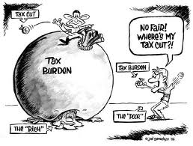
Ability-to-Pay Principle
The ability-to-pay principle is the idea that taxes should be levied on a person according to how well that person can shoulder the burden.

Slide 8
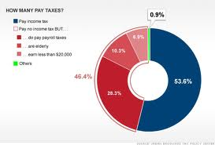

Slide 9
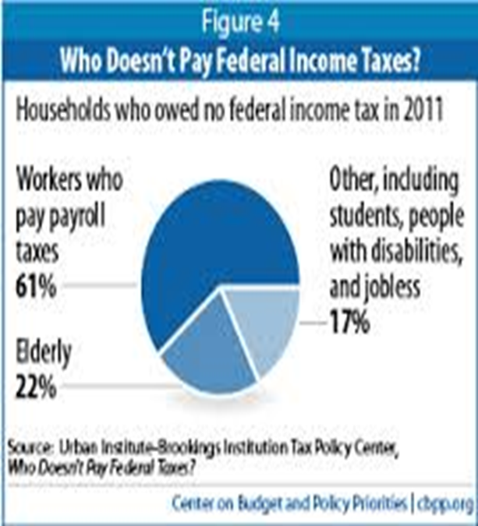

Slide 10
Economic Impact of Taxes
Resource Re-allocation
  Tax placed on a good or service can raise the cost of production and the price of the good.
  Ex: 1991 Luxury Tax
2. Behavior adjustment
Taxes are used to encourage or discourage certain types of activities
Ex: Smoking; Gasoline consumption
Productivity and Growth
Change incentives to save, invest, and work
Ex: People may not want to work to earn additional income it if will be taxed away
10

Slide 11
Three Types of Taxes
1. Progressive Taxes -takes a larger percent of income from high income groups (takes more from rich people).
Ex: Current Federal Income Tax system
2. Proportional Taxes (flat rate) –takes the same percent of income from all income groups.
Ex: 20% flat income tax on all income groups
3. Regressive Taxes –takes a larger percentage from low income groups (takes more from poor people).
Ex: Sales tax; any consumption tax.
11

Slide 12
What kind of taxes are these? (THINK % of Income)
Toll road tax ($1 per day)
State income tax where richer citizens pay higher %
$1.45 tax on cigarettes
Medicare tax of 1% of every dollar earned
8.75% California sales tax
12
Notes:
Regressive
Progressive
Regressive
Proportional
Regressive

Slide 13
Federal Income Tax Debate
Equal Tax of $350 per week (Regressive Tax)
Income Amount of Tax % Amount to live on
$200 $350 175% -$150)[crime?]
$350 $350 100% $0
$500 $350 70% $150
$1,000 $350 35% $650
$5,000 $350 7% $4,650
Tax of 20% per week (Proportional Tax)
Income Amount of Tax Amount to live on
$200 $40 $160
$350 $70 $280
$500 $100 $400
$1,000 $200 $800
$5,000 $1,000 $4,000
13

Slide 14
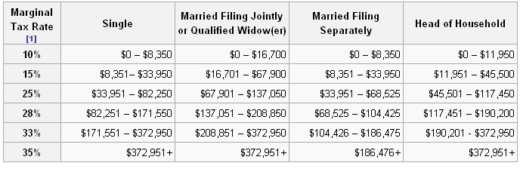
Federal Income Tax Debate
This is our current system. Is it fair?

Slide 15
Sources of Government Revenue:
Individual Income Tax: State and Federal; Higher income levels pay higher amount of tax (progressive)
2. Payroll taxes: Tax on wages that firms pay their workers (social security, medicare)
Excise Taxes: Taxes on the sale of specific goods such as cigarettes, gasoline, alcohol.
Property Taxes: Tax on land and improvements
Estate taxes: Tax on transfer of the estate of a deceased person
Corporate Income Tax: Taxes paid by businesses that are structured as corporations (in addition to personal taxes paid by the people that work there or receive dividends)
Customs Duties: Taxes paid on goods that are imported or exported
15

Slide 16
Receipts of the Federal Government...
Individual Income Tax, 47%
Social Insurance
Tax, 34%
Corporate Tax,
10%
Other, 9%

Slide 17
U.S. Federal Receipts - 2012
The Obama administration's February 2012 budget request contained $2.902 trillion in receipts and $3.803 trillion in outlays, for a deficit of $901 billion
Total receipts (in billions of dollars):
Item | Requested
Individual income tax | 1,359
Social Security and other payroll tax | 959
Corporate income tax | 348
Excise tax | 88
Customs duties | 33
Estate and gift taxes | 13
Deposits of earnings and Federal Reserve System | 80
Other miscellaneous receipts | 21
Total | 2902

Slide 18
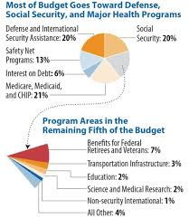
Budget Expenditures...

