Slide 1
Putting together your
History Day Project
Leadership and Legacy

Slide 2
Making an exhibit
exhibit category is three dimensional and is displayed on a physical structure. Exhibits use color, images, documents, objects, graphics, and design, as well as words, to tell your story. Exhibits can be interactive experiences by asking viewers to play music, solve a puzzle, look at a video, or open a door or window to see more documents or photos

Slide 3
Research the topic first. Do your secondary research first. Reading secondary resources will help you understand your subject more completely, point you to primary sources, and assist you in selecting the important themes you want to investigate and the key questions you want to ask.
Select items to put on the exhibit. You won't be able to use all the materials you find while doing your research. As you think about what to put on the exhibit, ask yourself the following questions:
Does the item fit in with the NHD theme and the theme of your exhibit?
-Does the item advance the story you are trying to tell?
-Is a document you are thinking of displaying too long or too wordy? Is it easy to read and understand? Will it take up too much space in your exhibit?
-Is the item visually interesting?
-What images best tell your story?
-Do you want to include artifacts in your exhibit?
-Will your exhibit contain audiovisual materials?
Prepare the script. Writing your titles, text, and labels is often referred to as writing the script. Like all good writing, your exhibit script needs to be grammatically correct, use good sentence structure, make wise word choices, and contain no spelling errors. You should expect to write several drafts. Exhibit labels are brief, so they need to be clear and concise.

Slide 4
NHD Steps:
Develop paperwork management system
Select a topic (think about what you are interested in)
  A. Topic you are PLANNING on researching- (20+ years ago)
  B. Reasons you choose that leader
Background reading (build context from lots of sources – KEEP TRACK OF SOURCES- must be primary or secondary only)
Narrow the topic – See me for sample list
Gather and record information (full info on all sources & how you use each)
National Archives http://www.archives.gov/research/
Library of Congress www.loc.gov
Search Engines for Academic Research
http://www.teachthought.com/technology/100-search-engines-for-academic-research/
6. Analyze and interpret sources (who created it, why, when, etc.)
7. Develop thesis (argument about topic)
8. Finalize and put together project- write a conclusion with your opinion

Slide 5
Things to include:
(suggested)
Historical background introduction- “set the scene”. Time, place, era.
Person’s biography…in your own words
Map…location in the world
Graphs…if applicable. Populations, demographics, statistics.
Highlight a “moment that changed history”
Photographs, images, visuals.
500 word limit.

Slide 6
Lay it out…(example)
Image(s)
Map
Biography
Incident
Graph
Quotes- cited

Slide 7
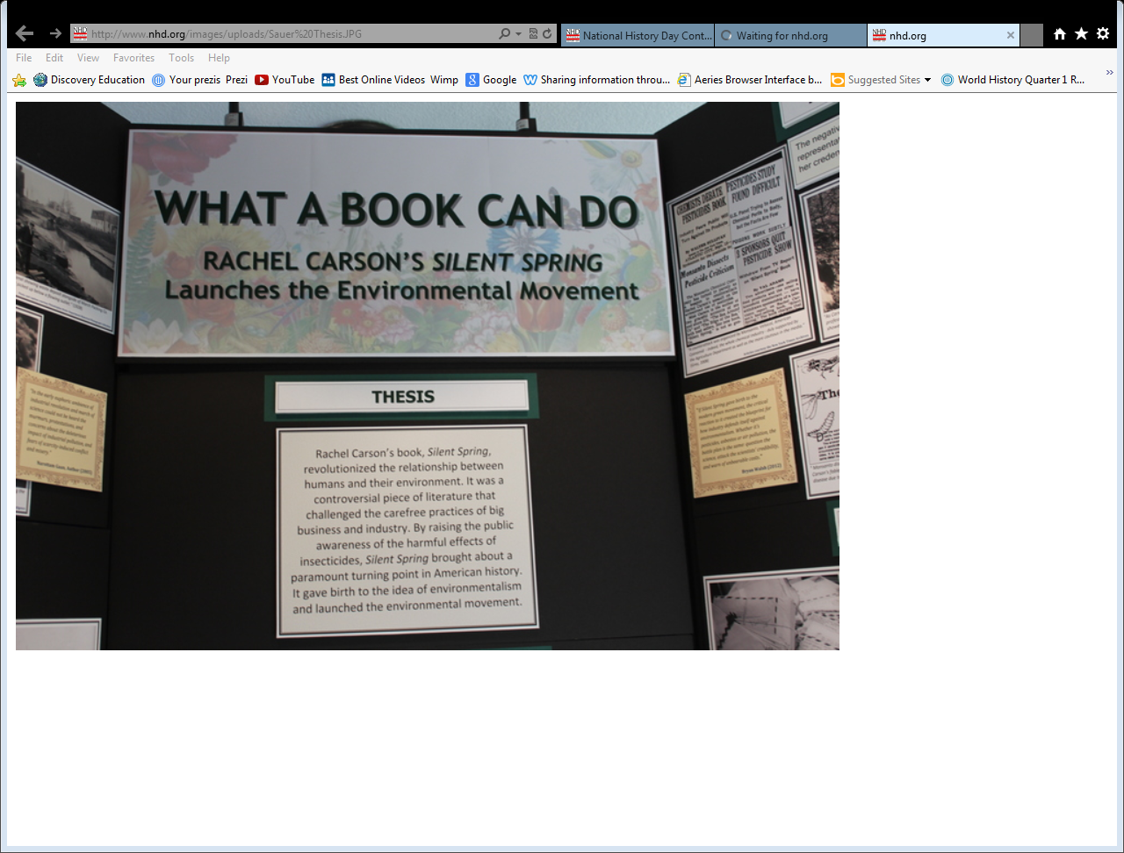

Slide 8
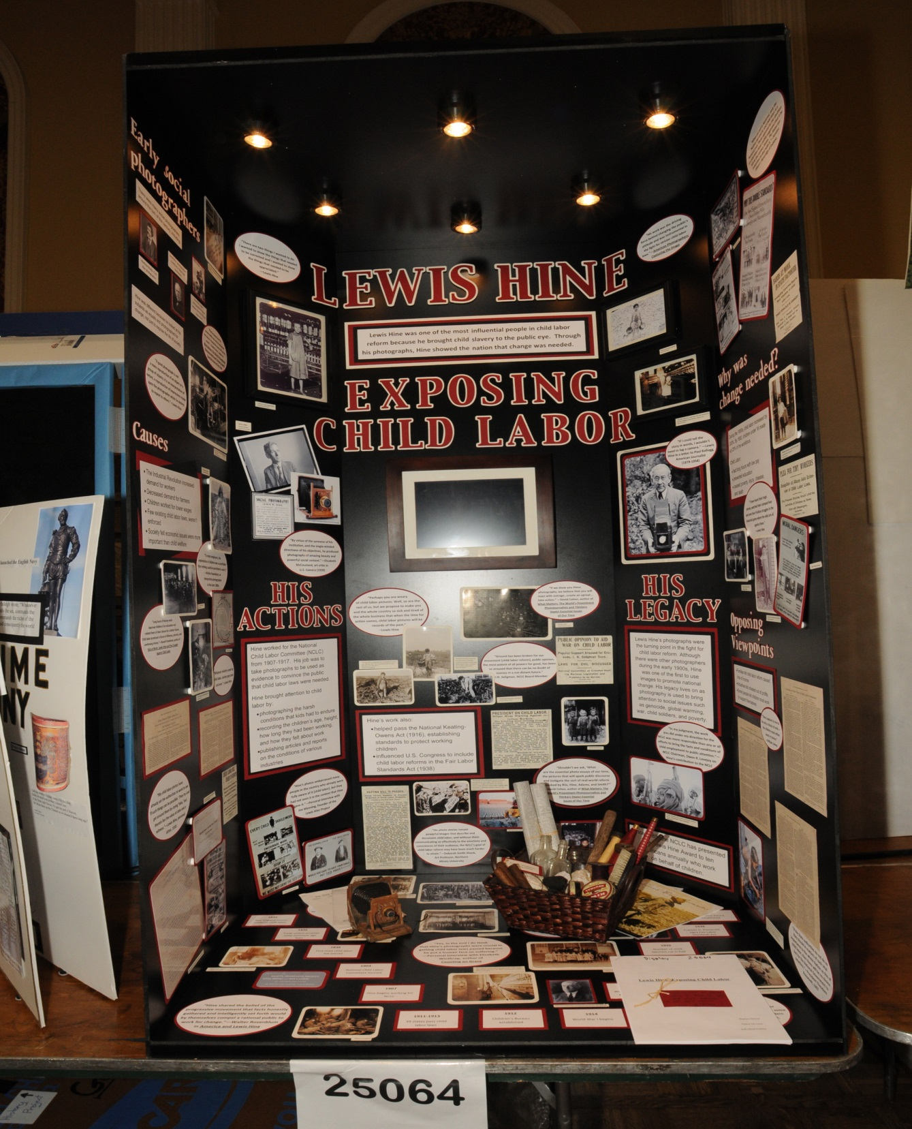
Example #2:

Slide 9
Finalize and put it together…
Submit it no later than December 7th.
Make it your best effort!

